Slide 1
Mental Health and Suicide rate impacts worldwide
By Group 4

Slide 2
Overview Of Our Project
In the last decade we’ve seen an increase in concern in the media about mental health. Is mental health a new problem or was it just not publicized like it is now? In our project we are looking to answer a few questions about suicide rate worldwide. Our data includes data from over 100 countries and includes various other relevant data point for example the sex of the people commiting suicide in each country. Our data spans from 1985 - 2016.
What do we want to know?
Are younger generations more susceptible to mental health problems and suicide?
Which sex is committing suicide at a higher rate worldwide?
Which regions of the world are commuting suicide at a higher rate?
Does a country’s economy (GDP) affect suicide rates?
Over the years has suicides and bad mental health become a silent pandemic?

Slide 3
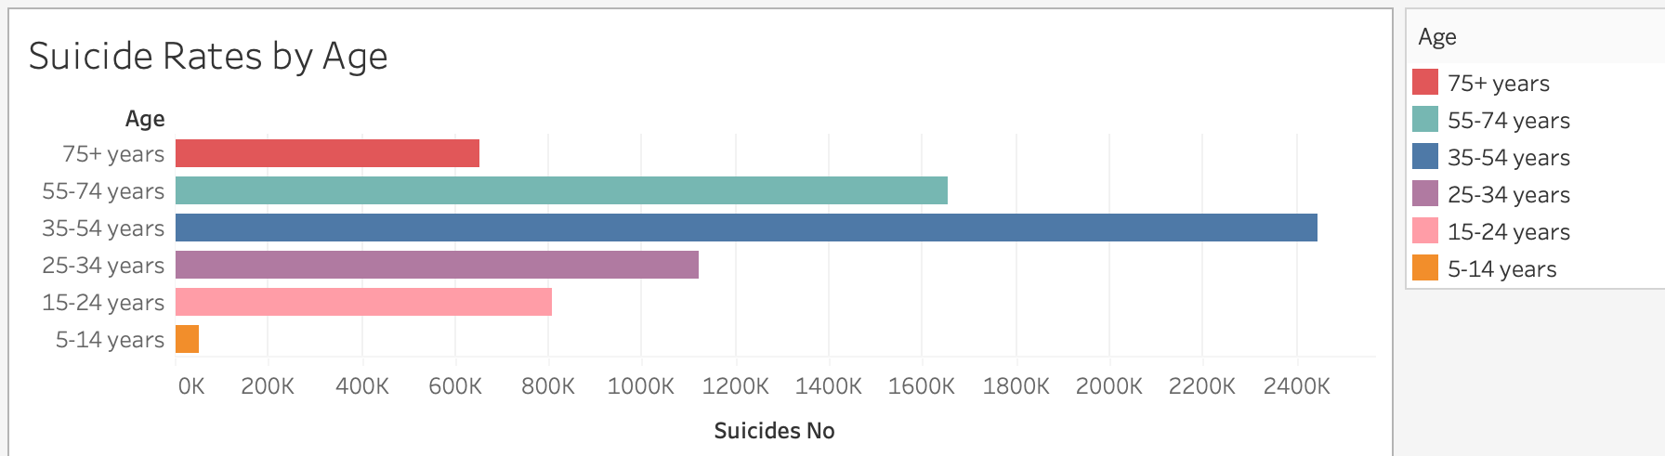
Are younger generations more susceptible to mental health problems and suicide?
When we were creating the questions we created hypothesis of what we thought the answer would be. For this questions we assumed more suidice would be in people 30 or below. Through analyzing the data we discovered that in fat 34-54 year olds are more susceptible to suicides over any other age group.

Slide 4
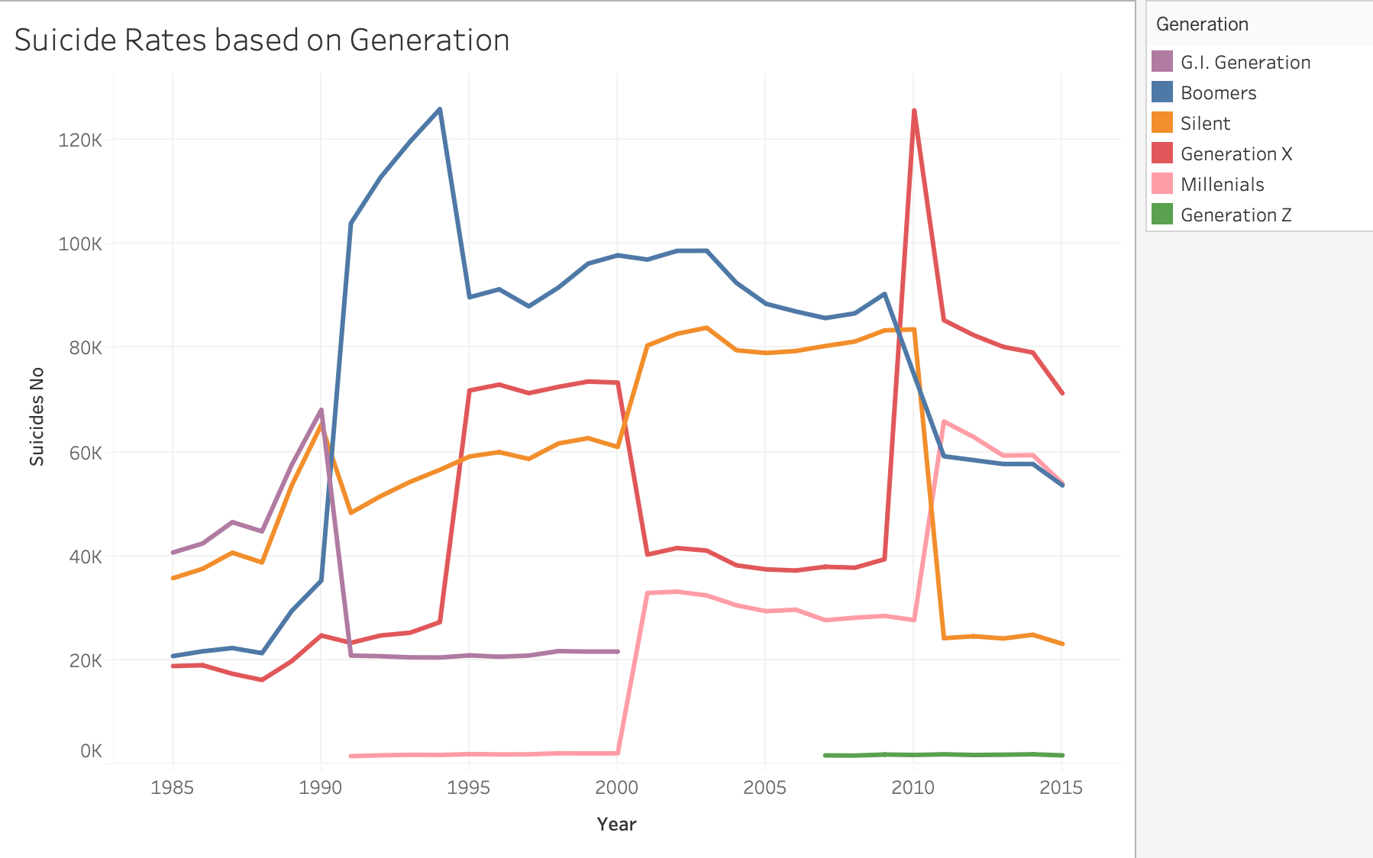
Suicide rates based on generations:
As we can see on the graph different generations had spikes of suicides along the years. One that particularly stood out to us was that Gen x had a massive spike in suicides between the year 2008 and 2012. This caught our attention because gen x was the most affected by the housing crisis. Many families were put in trying positions and we’re sure that mental health was in crisis as well during that time.

Slide 5
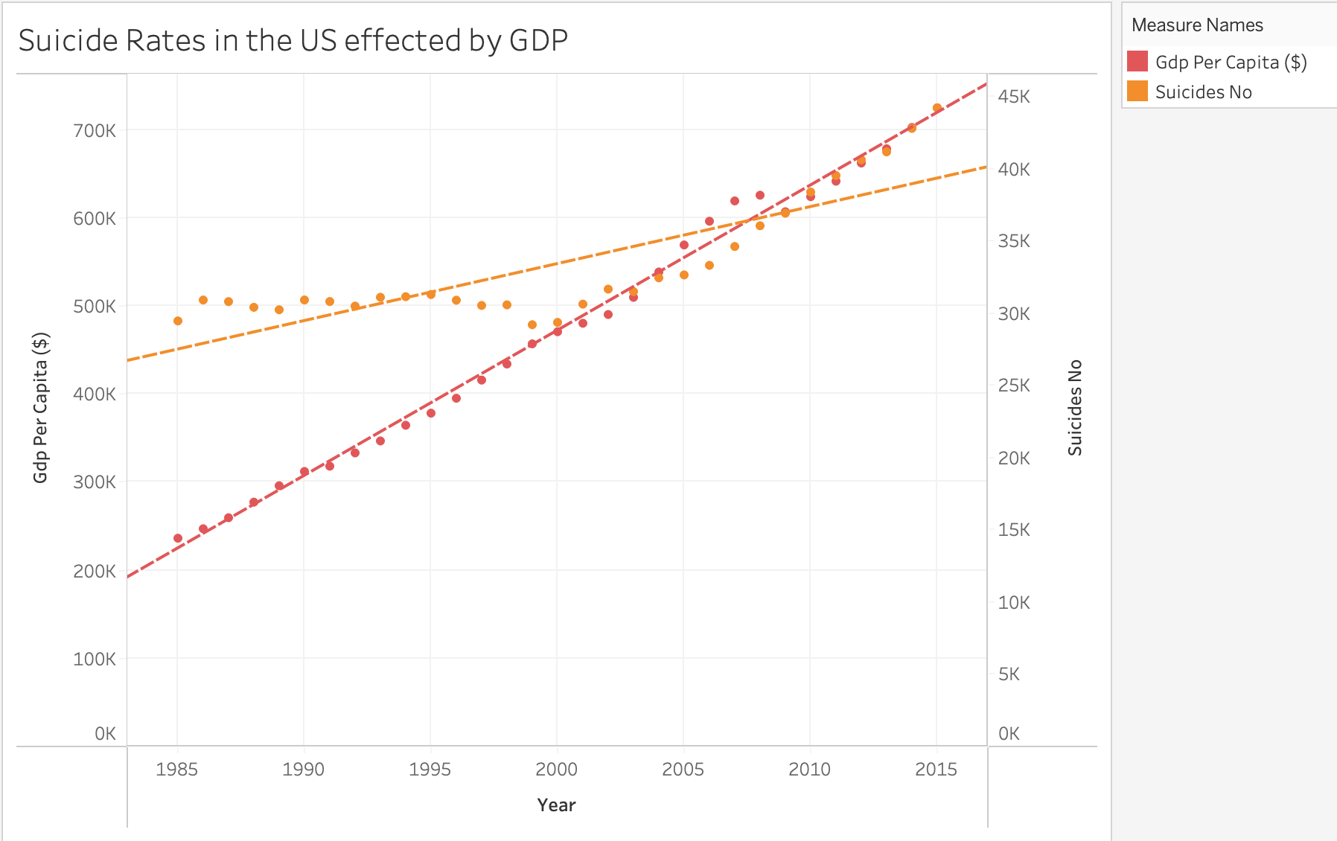

Slide 6
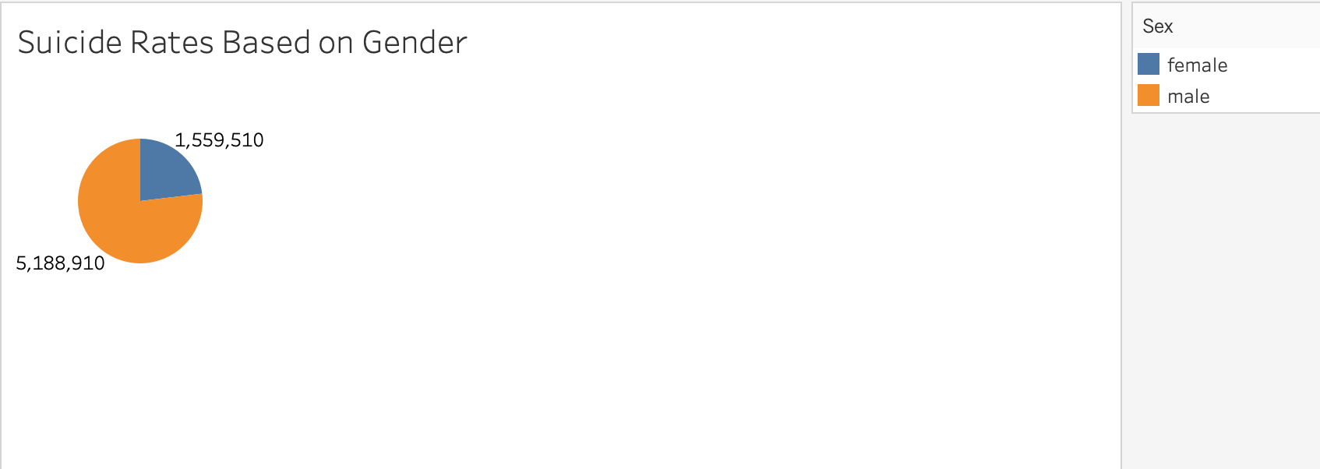
Which sex is committing suicide at a higher rate worldwide?
Our analysis has shown that men commit suicide worldwide at a higher rate than women. This number is not just a slight difference, it is staggering. Mental health might not be just a men problem but due to societal pressures and stereotypes less men seek help when struggling with mental health. Less men go to therapy, less men use anti depression medication, and more men feel the need to internalize their problems. All these factors lead to men having a high rate on suicide. About 73% of all suicide were men.

Slide 7
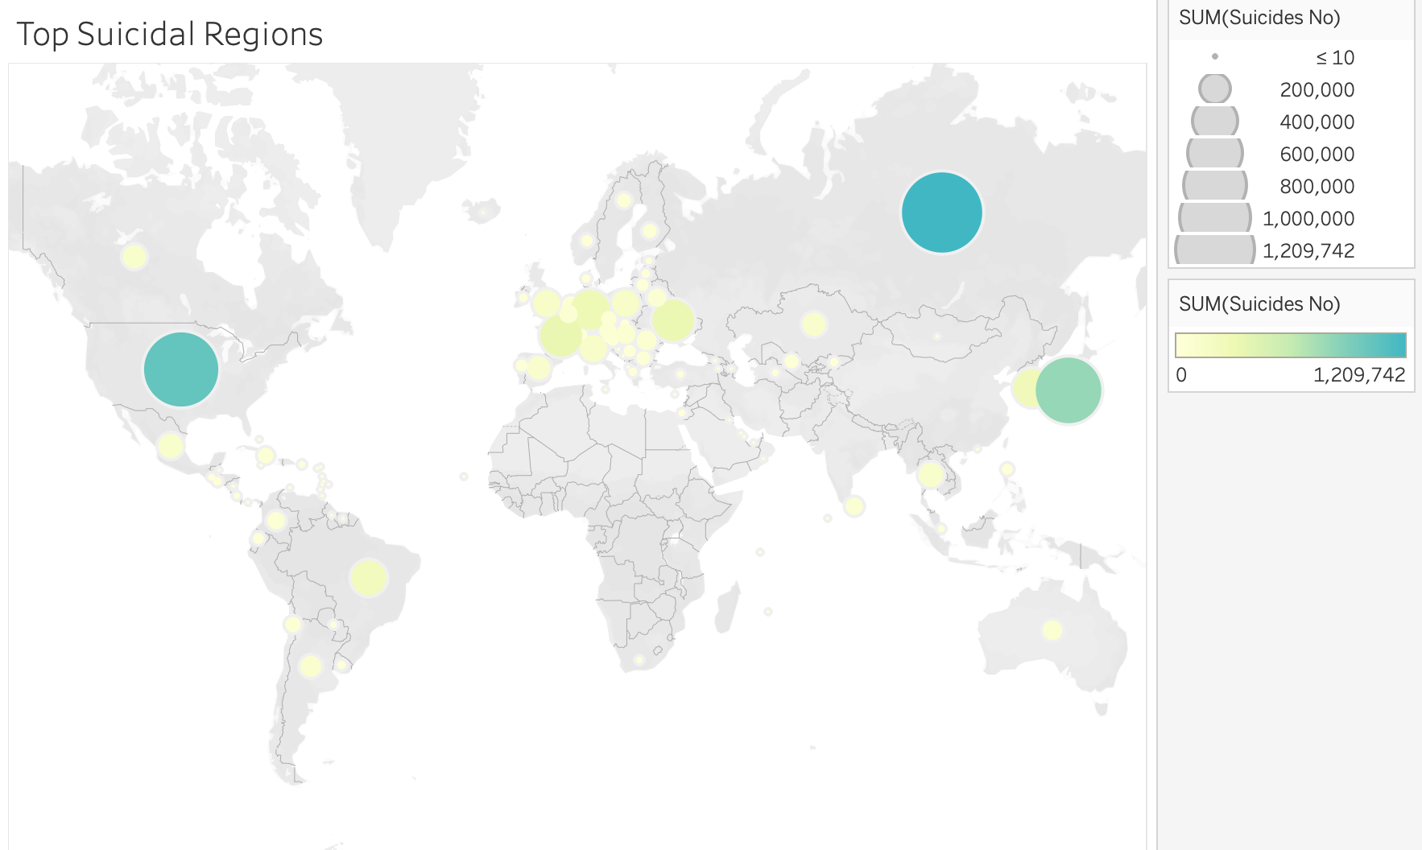
Which regions of the world are commuting suicide at a higher rate?
During our analysis of the data we uncovered that 1st world countries had more suicides per capita than anywhere else in the world. Our conclusion for the reasoning came to the reporting of the suicides and the other leading causes of death in those countries due to lack of resources.

Slide 8
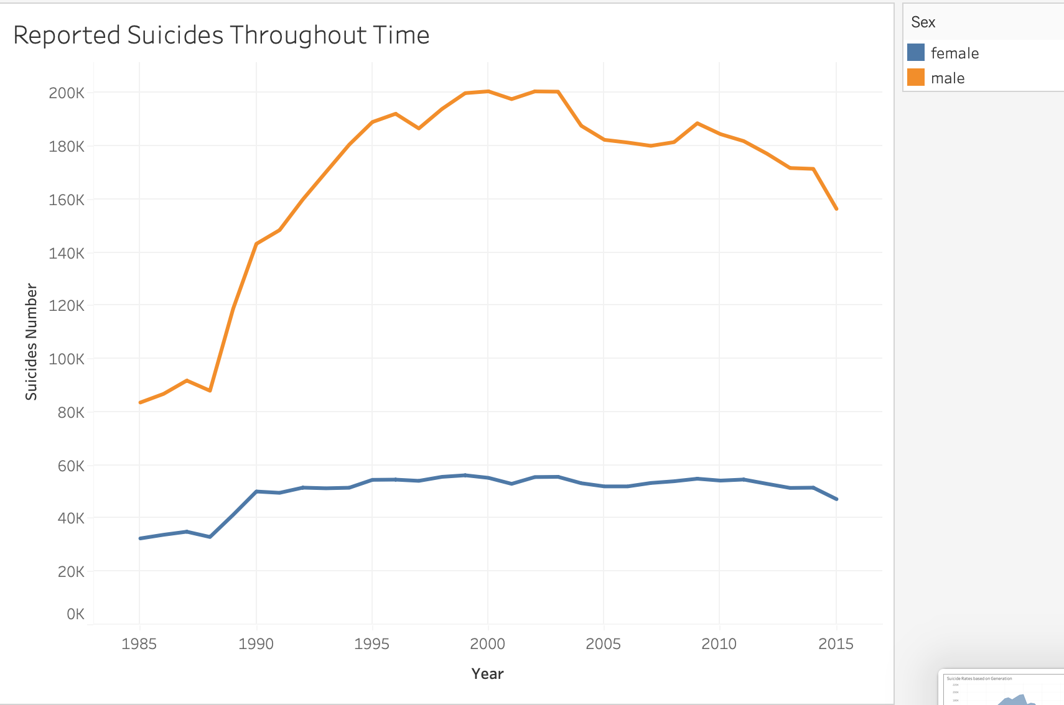
Over the years has suicides and bad mental health become a silent pandemic?
This graph shows the suicide rates throughout time for males and females. What we noticed is that men have exponentially increased while women have stayed about the same.

Slide 9
Description
The model we believed would fit best with our dataset is the Supervised Machine Learning Model.
We first noticed that the data we had found provided the labels we needed in order to predict possible future trends.
The labels gave us the “answers” and it was our job to explain the trend that is occurring based on what was given to us.
In order to best look for trends, we believed using multiple algorithms per comparison can give us many different angles to look through.
The algorithms we found to be the best for our data include:
BalancedRandomForestClassifier (multiple weaker trees used together can create a strong model)
SMOTEEN (using a combination of over and undersampling by dropping two nearest neighbors belonging to two different classics)
RandomOverSampler (the majority and minority classes are randomly selected and added)
We used Tableau in order to provide visualizations of the different correlations seen due to the many factors that can lead to suicide.
We also used pgAdmin in order to create, display, and edit our tables

Slide 10
Benefits and Limitations of a Supervised Machine Learning Model (and the algorithms)
Benefits:
Despite machine learning being a relatively advanced topic, the process of applying machine learning to our dataset was pretty straightforward. Since we are already given the labels (the “answers” in other words), all we had to do was find the right algorithm to use.
In addition, the algorithms used all have the same flow by requiring similar code in order to get the results we need. An example being the similar code is used to get the confusion matrix as well as printing out the accuracy scores.
Limitations:
The first limitation we had with our model was with the dataset itself. The dataset goes until 2016 which means the model’s predictions can possibly more inaccurate the more time passes.
Also, in order to get the best results, we need to make good comparisons when it comes to coding itself. This is made apparent when there are too many factors in the dataset for the model to make the best predictions. This in turn causes some of the algorithms predictions and accuracy to be lower than we had hoped.
This isn't necessarily the fault of the algorithm but it's something to take note of when working with slightly older data as well as a lot of factors to take into account all at once.

